Slide 1
BR US Time to Next Purchase Prediction Model
MAY 2017
PLATFORM ANALYTICS

Slide 2
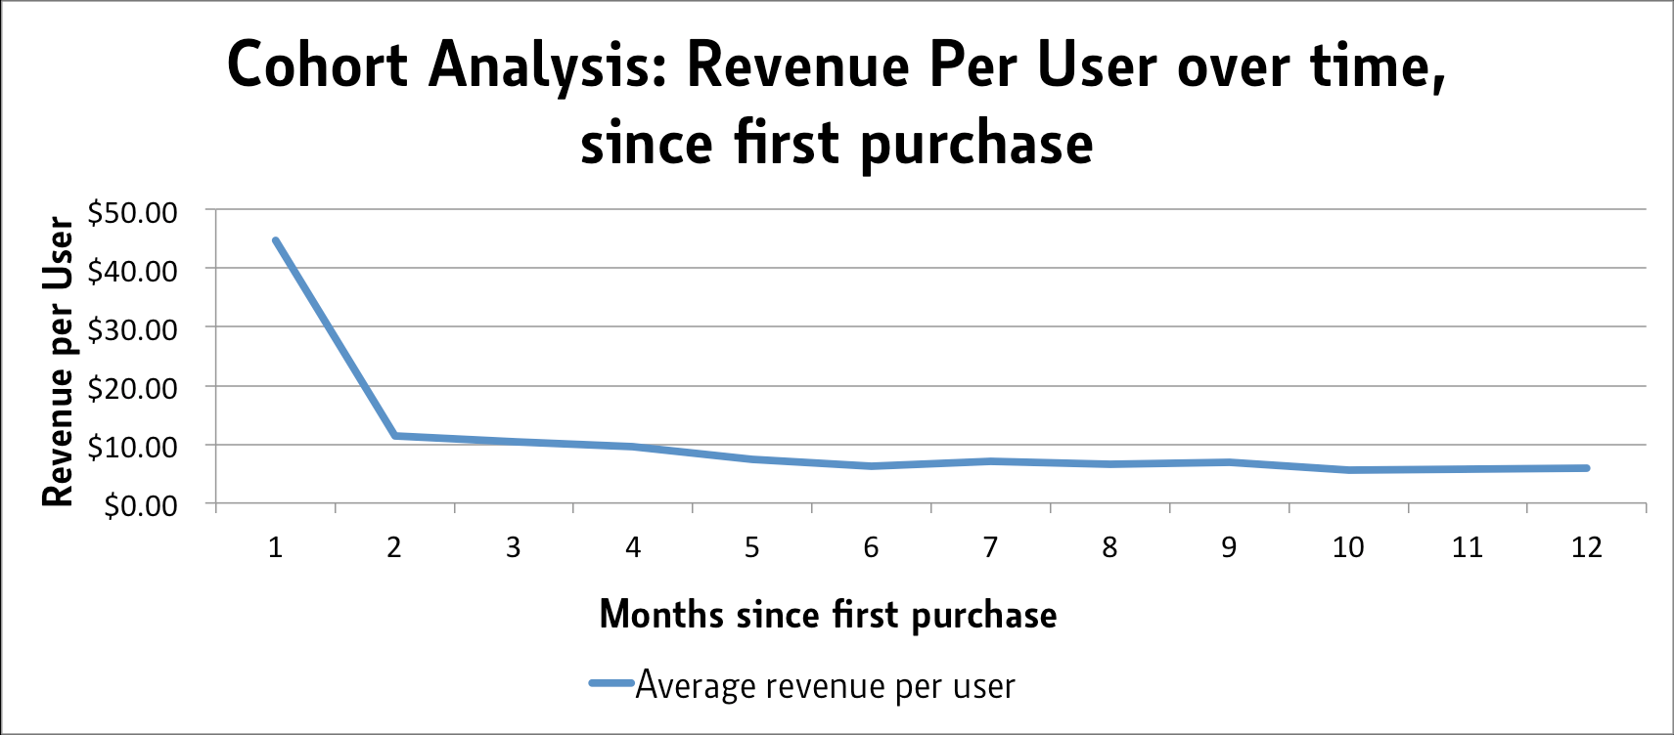


BACKGROUND
Next Purchase Prediction Model enables answering Questions Like
When is the customer most likely to make a purchase ?
When should a customer be targeted on a longer time scale.
Who is most likely to make a purchase at a given time ?
Should the customer be targeted in our next campaign.
Explaining Tradeoffs between various customer cohorts ?
Who is a better target?
A more frequent buyer or a less frequent buyer who hasn’t bought in a long time

Slide 3
Model Validations – 1 Month
Scope: BR US
Algorithm: Classification Models/GBM
Data: Yearly Transaction Data + 3 months Browse Data
Platforms & Packages: Hive, R
In Time Window
Purchase
06/1/2015- 06/30/2016
Purchase Data
7/1/2016- 7/31/2016
Out of Time Window
Purchase
02/1/2016- 01/31/2017
Purchase Data
2/1/2017- 2/28/2017
Training Window
Validation Window
Data preparation
Exploratory Analysis
Scaling and Outlier Treatment
Training Dataset : 20,000 customer-keys
Testing Dataset : 4,657,520 customer-keys
Model Execution and Testing
Model Evaluation and Validation
Model Training

Slide 4
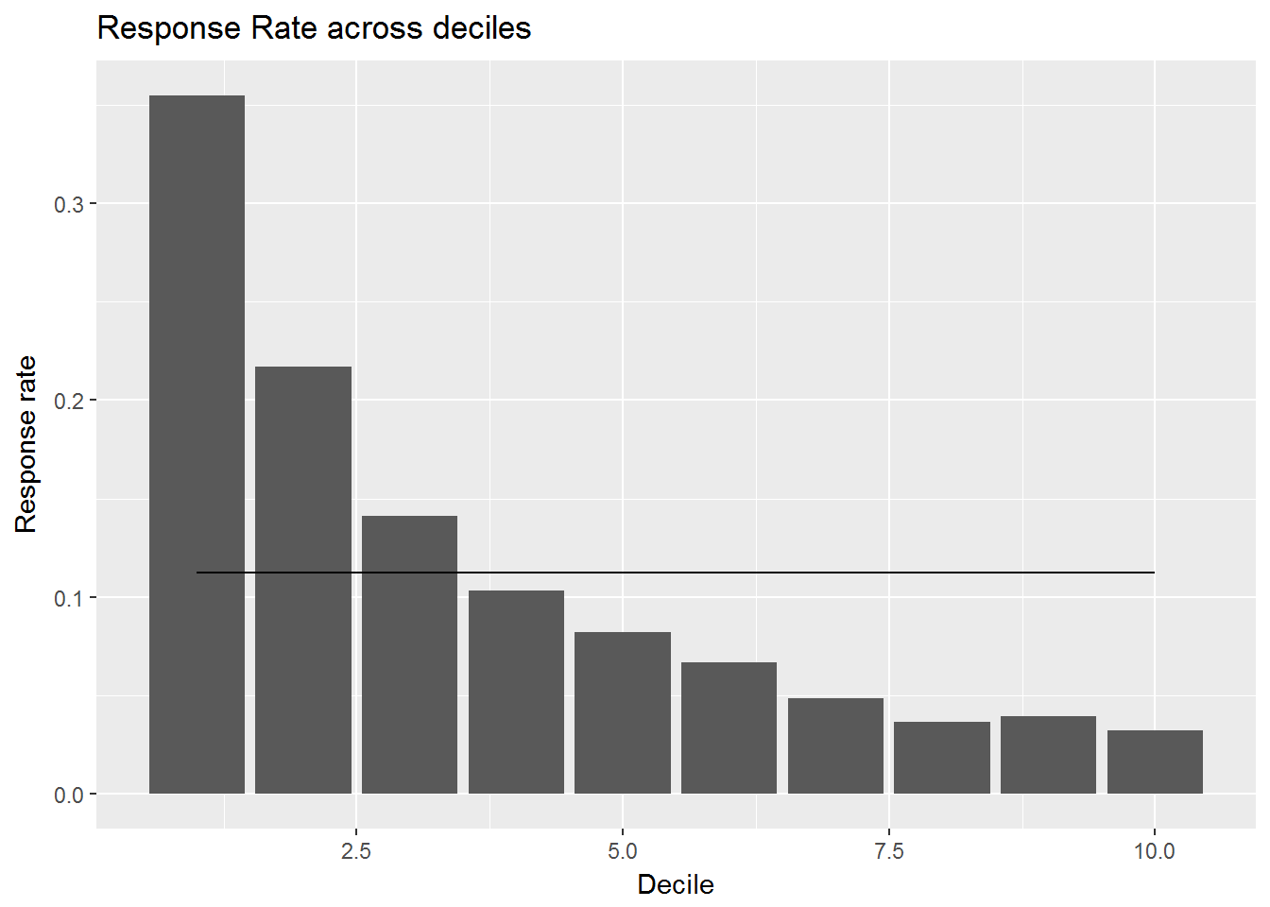
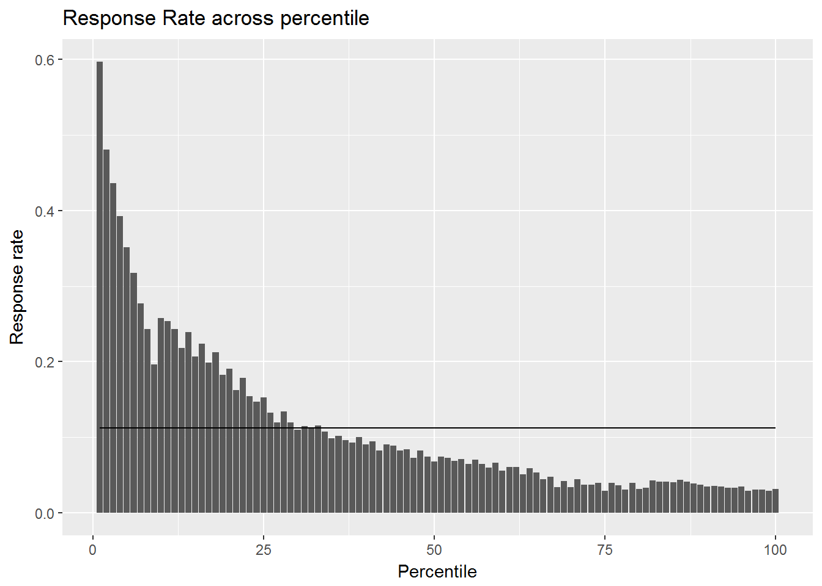
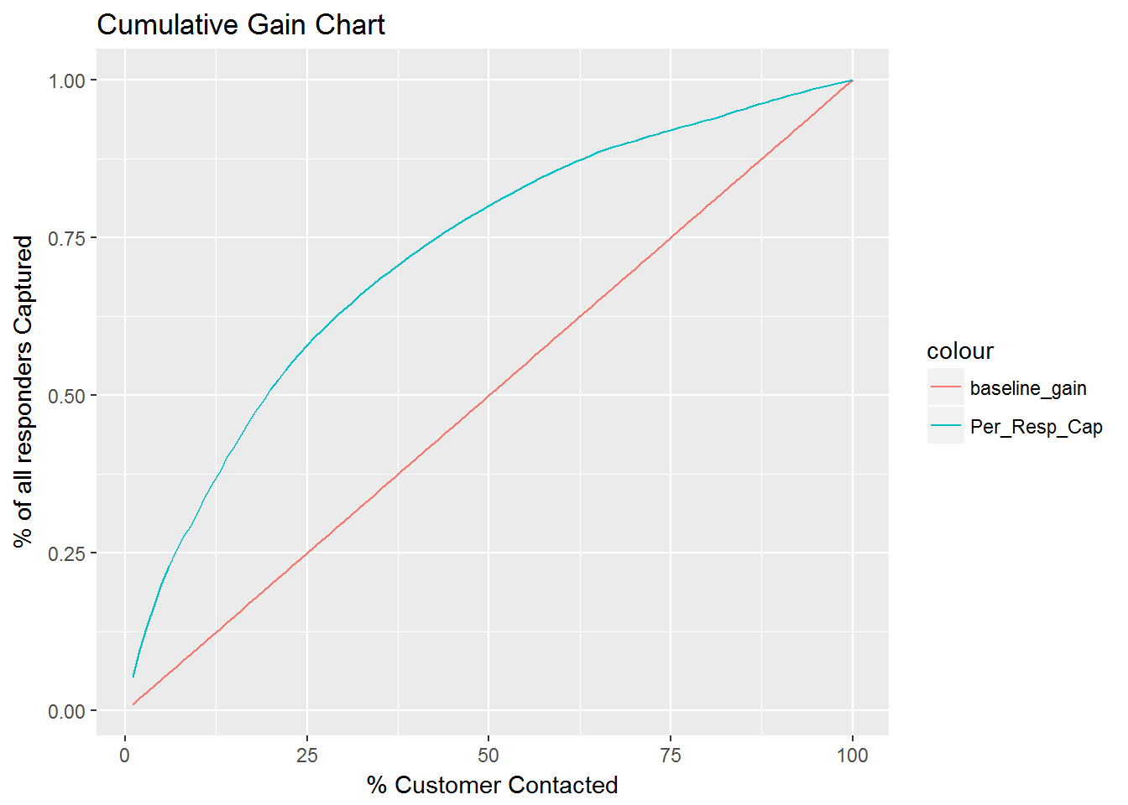
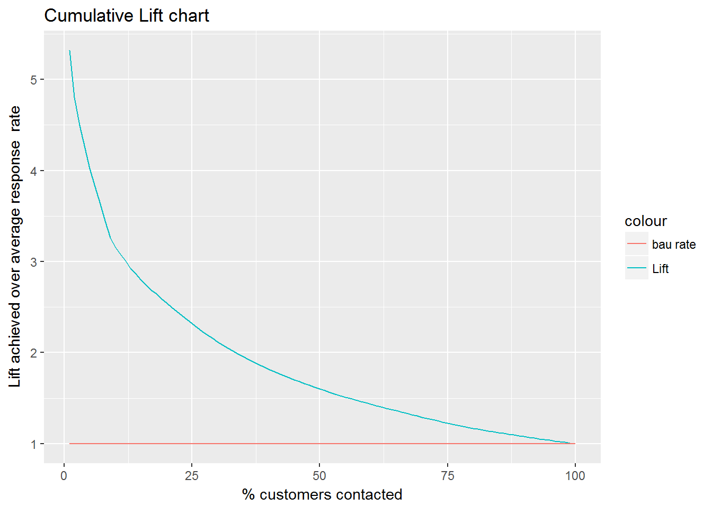
MODEL VALIDATIONS- 1 Month In Time
Decile | Customers | Number of Responder | Cum Responders | Response Rate | Response Gain | Cumulative Response Rate | Lift
1 | 465,752 | 277,322 | 277,322 | 59.54% | 25.71% | 59.5% | 2.57
2 | 465,752 | 199,552 | 476,874 | 42.85% | 44.20% | 51.2% | 2.21
3 | 465,752 | 140,910 | 617,784 | 30.25% | 57.26% | 44.2% | 1.91
4 | 465,752 | 110,070 | 727,854 | 23.63% | 67.47% | 39.1% | 1.69
5 | 465,752 | 92,866 | 820,720 | 19.94% | 76.07% | 35.2% | 1.52
6 | 465,752 | 74,940 | 895,660 | 16.09% | 83.02% | 32.1% | 1.38
7 | 465,752 | 52,916 | 948,576 | 11.36% | 87.92% | 29.1% | 1.26
8 | 465,752 | 42,188 | 990,764 | 9.06% | 91.84% | 26.6% | 1.15
9 | 465,752 | 47,773 | 1,038,537 | 10.26% | 96.26% | 24.8% | 1.07
10 | 465,752 | 40,314 | 1,078,851 | 8.66% | 100.00% | 23.2% | 1.00
Model Summary:
Among many models , Xgboost algorithm was picked based on model performance.
Response Rate across deciles by median score from 20 models
Response Rate across percentiles by median score from 20 models
Cum Gains using median score from 20 models
Cum Lift using median score from 20 models

Slide 5
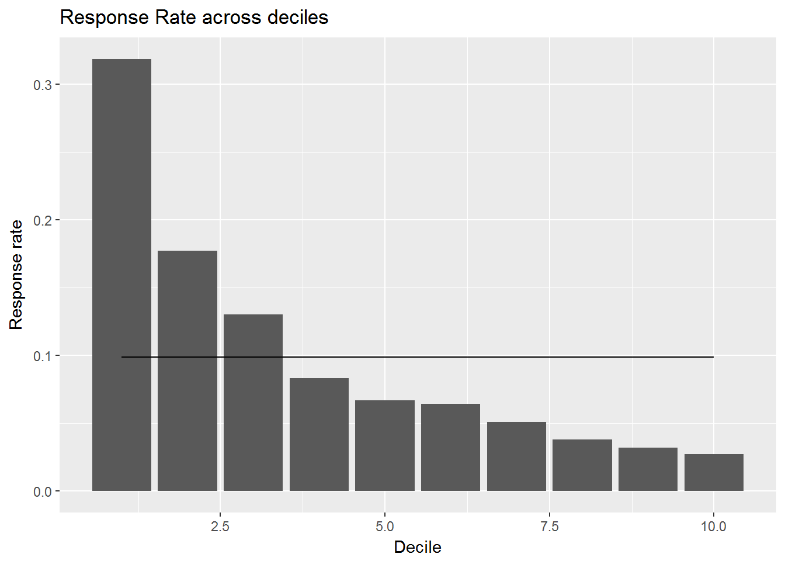
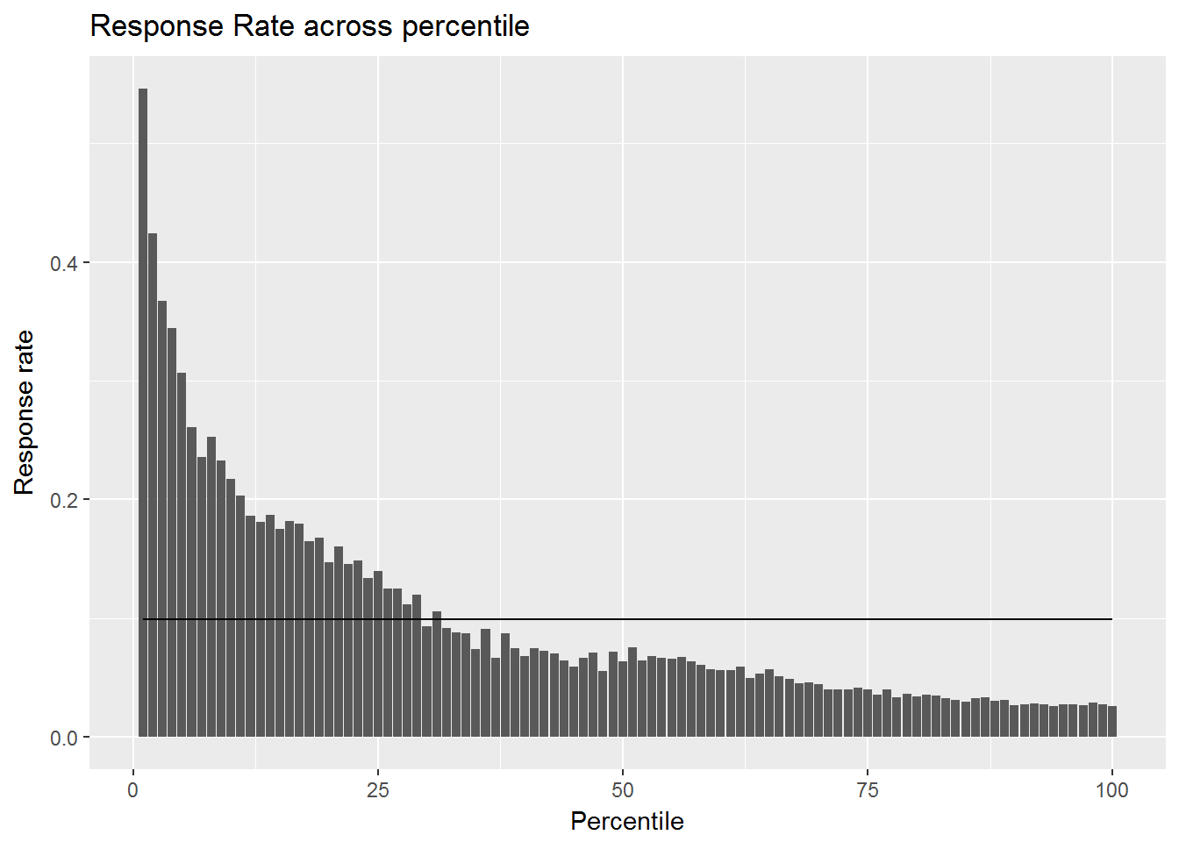
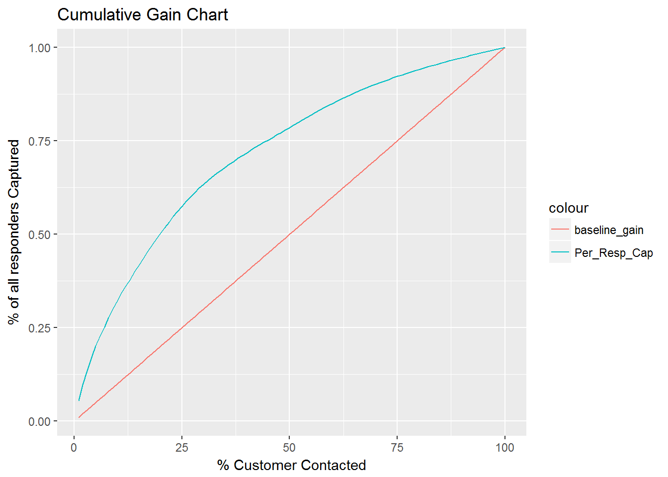
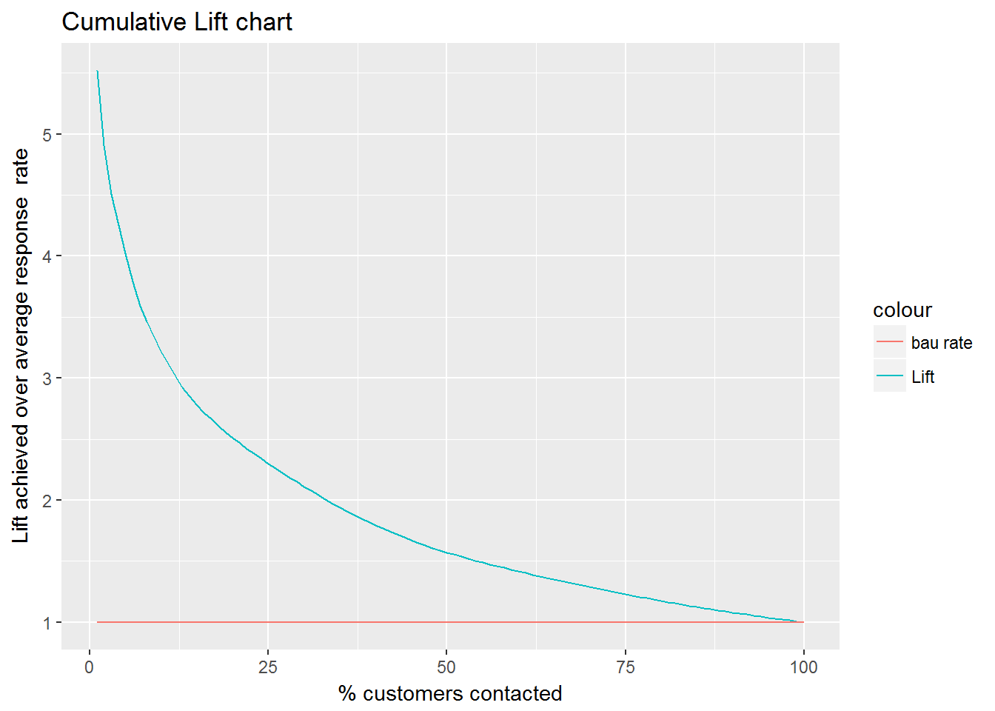
MODEL VALIDATIONS- 1 Month Out of Time
Decile | Customers | Number of Responder | Cum Responders | Response Rate | Response Gain | Cumulative Response Rate | Lift
1 | 429426 | 136933 | 136,933 | 31.89% | 32.22% | 31.9% | 3.22
2 | 429426 | 76158 | 213,091 | 17.73% | 50.14% | 24.8% | 2.51
3 | 429427 | 55976 | 269,067 | 13.04% | 63.32% | 20.9% | 2.11
4 | 429426 | 35803 | 304,870 | 8.34% | 71.74% | 17.7% | 1.79
5 | 429427 | 28762 | 333,632 | 6.70% | 78.51% | 15.5% | 1.57
6 | 429426 | 27683 | 361,315 | 6.45% | 85.02% | 14.0% | 1.42
7 | 429426 | 21937 | 383,252 | 5.11% | 90.19% | 12.7% | 1.29
8 | 429427 | 16342 | 399,594 | 3.81% | 94.03% | 11.6% | 1.18
9 | 429426 | 13665 | 413,259 | 3.18% | 97.25% | 10.7% | 1.08
10 | 429427 | 11694 | 424,953 | 2.72% | 100.00% | 9.9% | 1.00
Model Summary:
Among many models , Xgboost algorithm was picked based on model performance.
Response Rate across deciles by median score from 20 models
Response Rate across percentiles by median score from 20 models
Cum Gains using median score from 20 models
Cum Lift using median score from 20 models

Slide 6
Model Validations – 3 Months
Scope: BR US
Algorithm: Classification Models/GBM
Data: Yearly Transaction Data + 3 months Browse Data
Platforms & Packages: Hive, R
In Time Window
Purchase
06/1/2015- 06/30/2016
Purchase Data
7/1/2016- 9/30/2016
Out of Time Window
Purchase
02/1/2016- 01/31/2017
Purchase Data
2/1/2017- 4/30/2017
Training Window
Validation Window
Data preparation
Exploratory Analysis
Scaling and Outlier Treatment
Training Dataset : 20,000 customer-keys
Testing Dataset : 4,657,520 customer-keys
Model Execution and Testing
Model Evaluation and Validation
Model Training

Slide 7
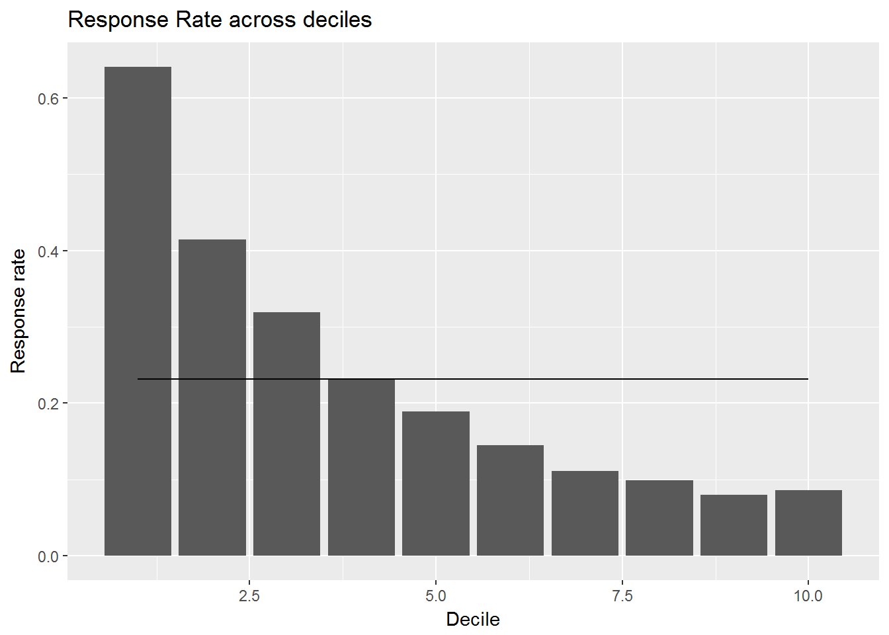
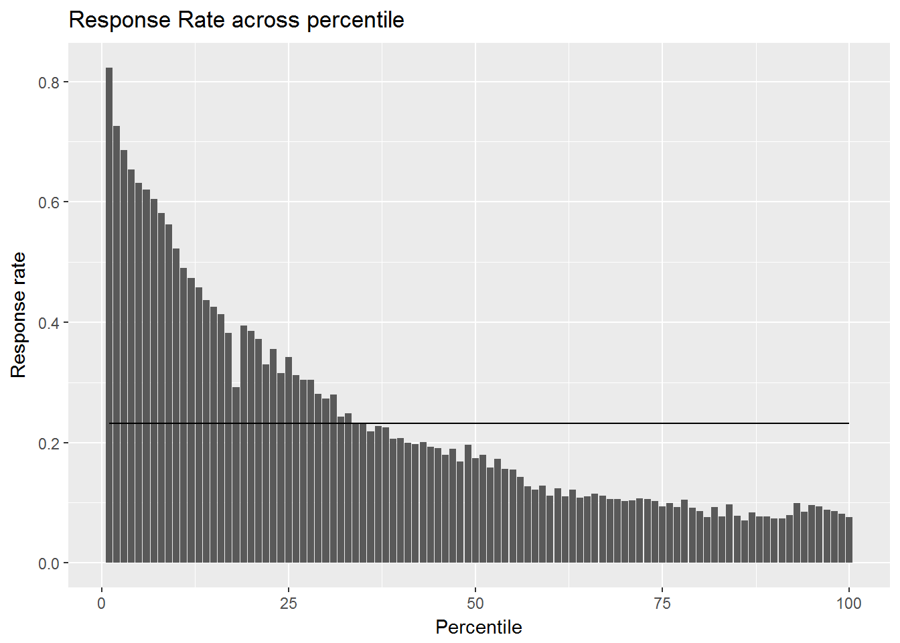
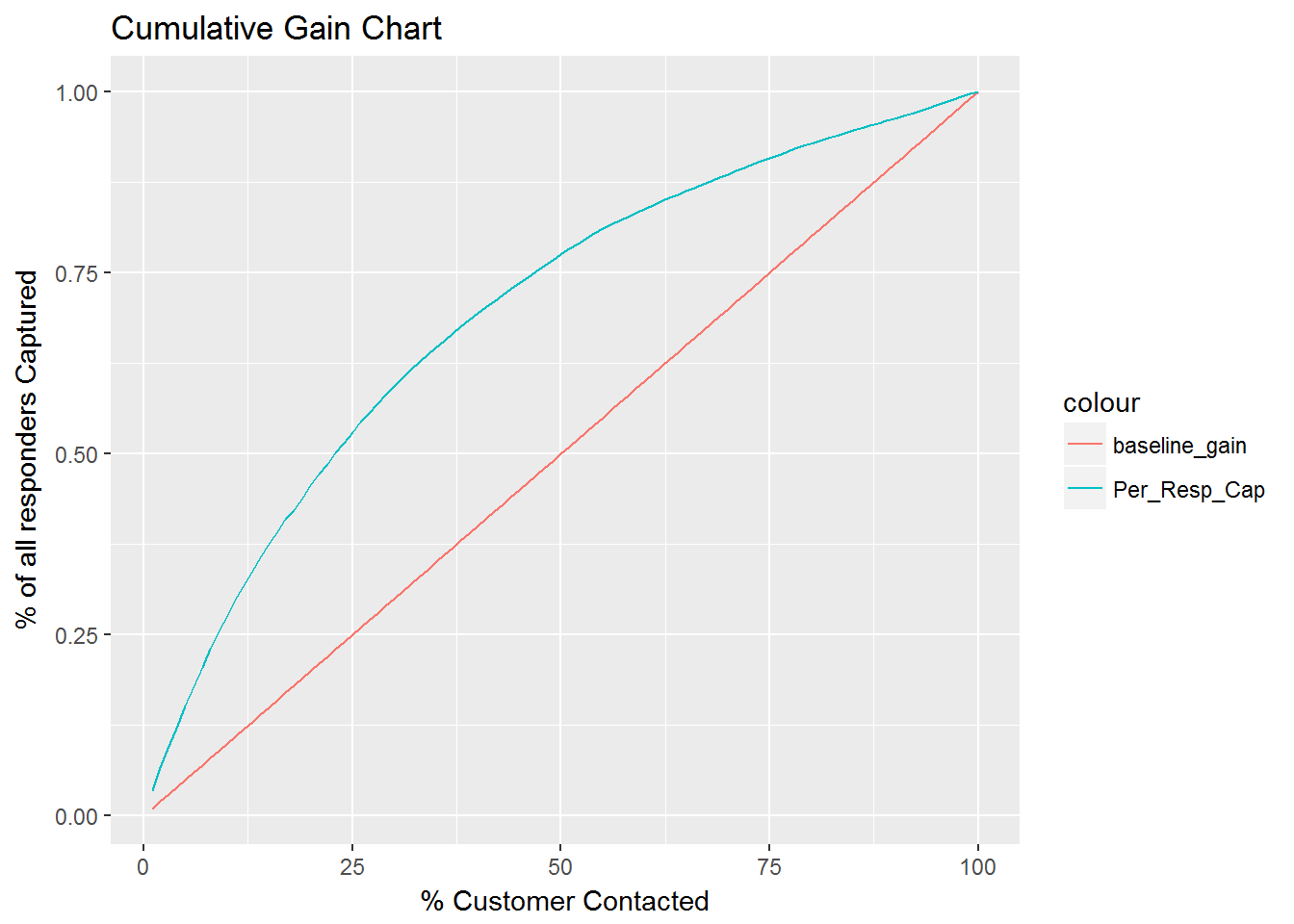
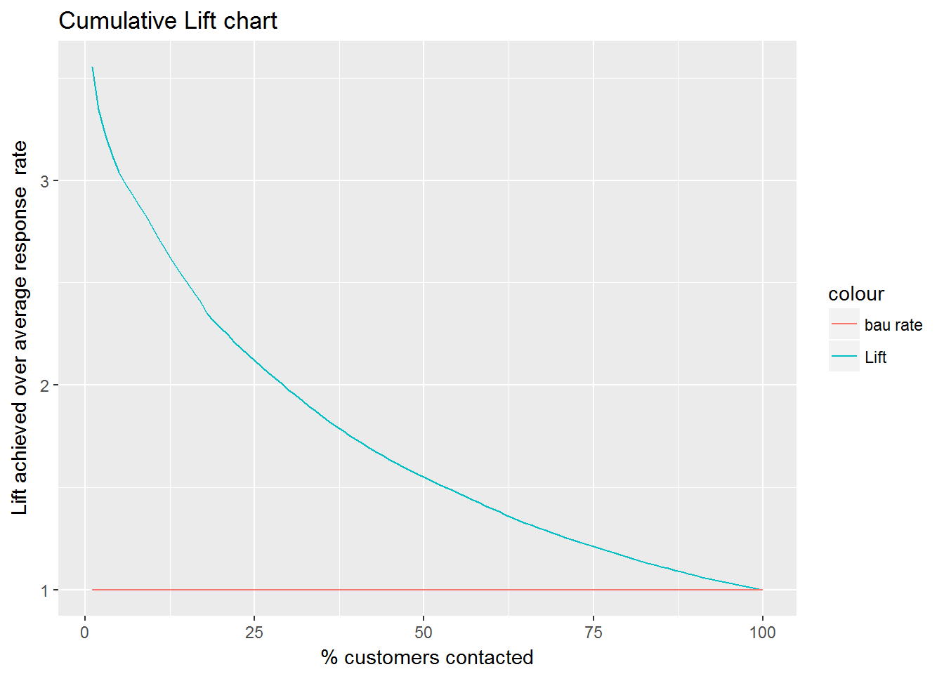
MODEL VALIDATIONS- 3 Months In Time
Decile | Customers | Number of Responder | Cum Responders | Response Rate | Response Gain | Cumulative Response Rate | Lift
1 | 465,752 | 298,632 | 298,632 | 64.12% | 27.68% | 64.1% | 2.77
2 | 465,752 | 193,226 | 491,858 | 41.49% | 45.59% | 52.8% | 2.28
3 | 465,752 | 148,529 | 640,387 | 31.89% | 59.36% | 45.8% | 1.98
4 | 465,752 | 107,914 | 748,301 | 23.17% | 69.36% | 40.2% | 1.73
5 | 465,752 | 87,904 | 836,205 | 18.87% | 77.51% | 35.9% | 1.55
6 | 465,752 | 67,643 | 903,848 | 14.52% | 83.78% | 32.3% | 1.40
7 | 465,752 | 51,936 | 955,784 | 11.15% | 88.59% | 29.3% | 1.27
8 | 465,752 | 45,970 | 1,001,754 | 9.87% | 92.85% | 26.9% | 1.16
9 | 465,752 | 37,258 | 1,039,012 | 8.00% | 96.31% | 24.8% | 1.07
10 | 465,752 | 39,839 | 1,078,851 | 8.55% | 100.00% | 23.2% | 1.00
Model Summary:
Among many models , Xgboost algorithm was picked based on model performance.
Response Rate across deciles by median score from 20 models
Response Rate across percentiles by median score from 20 models
Cum Gains using median score from 20 models
Cum Lift using median score from 20 models

Slide 8

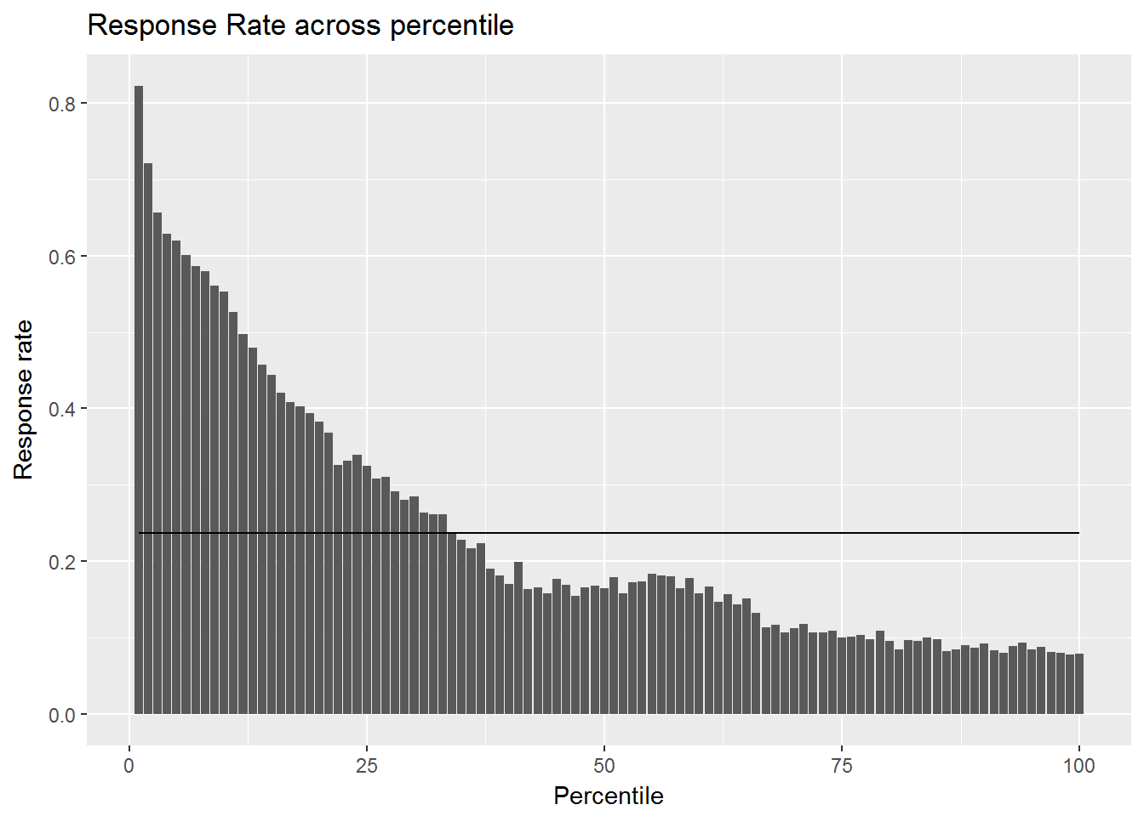

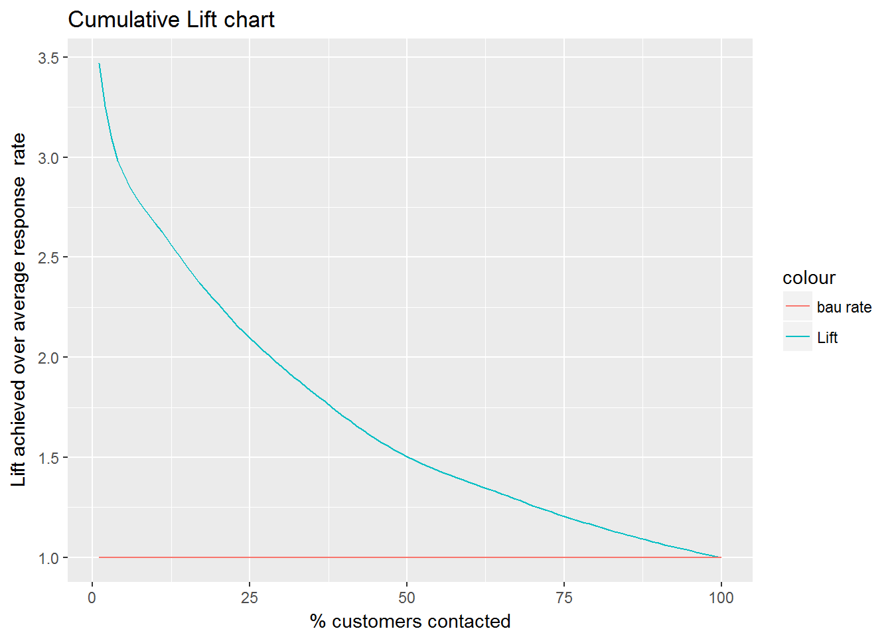
MODEL VALIDATIONS- 3 Month Out of Time
Decile | Customers | Number of Responder | Cum Responders | Response Rate | Response Gain | Cumulative Response Rate | Lift
1 | 429426 | 271598 | 271,598 | 63.25% | 26.68% | 63.2% | 2.67
2 | 429426 | 189500 | 461,098 | 44.13% | 45.30% | 53.7% | 2.27
3 | 429427 | 135869 | 596,967 | 31.64% | 58.65% | 46.3% | 1.96
4 | 429426 | 95940 | 692,907 | 22.34% | 68.08% | 40.3% | 1.70
5 | 429427 | 72414 | 765,321 | 16.86% | 75.19% | 35.6% | 1.50
6 | 429426 | 74344 | 839,665 | 17.31% | 82.50% | 32.6% | 1.37
7 | 429426 | 57805 | 897,470 | 13.46% | 88.18% | 29.9% | 1.26
8 | 429427 | 45015 | 942,485 | 10.48% | 92.60% | 27.4% | 1.16
9 | 429426 | 39242 | 981,727 | 9.14% | 96.46% | 25.4% | 1.07
10 | 429427 | 36067 | 1,017,794 | 8.40% | 100.00% | 23.7% | 1.00
Model Summary:
Among many models , Xgboost algorithm was picked based on model performance.
Response Rate across deciles by median score from 20 models
Response Rate across percentiles by median score from 20 models
Cum Gains using median score from 20 models
Cum Lift using median score from 20 models

Slide 9
Model Validations – 6 Months
Scope: BR US
Algorithm: Classification Models/GBM
Data: Yearly Transaction Data + 3 months Browse Data
Platforms & Packages: Hive, R
In Time Window
Purchase
06/1/2015- 06/30/2016
Purchase Data
7/1/2016- 12/31/2016
Out of Time Window
Purchase
02/1/2016- 01/31/2017
Purchase Data
Training Window
Validation Window
Data preparation
Exploratory Analysis
Scaling and Outlier Treatment
Training Dataset : 20,000 customer-keys
Testing Dataset : 4,657,520 customer-keys
Model Execution and Testing
Model Evaluation and Validation
Model Training

Slide 10
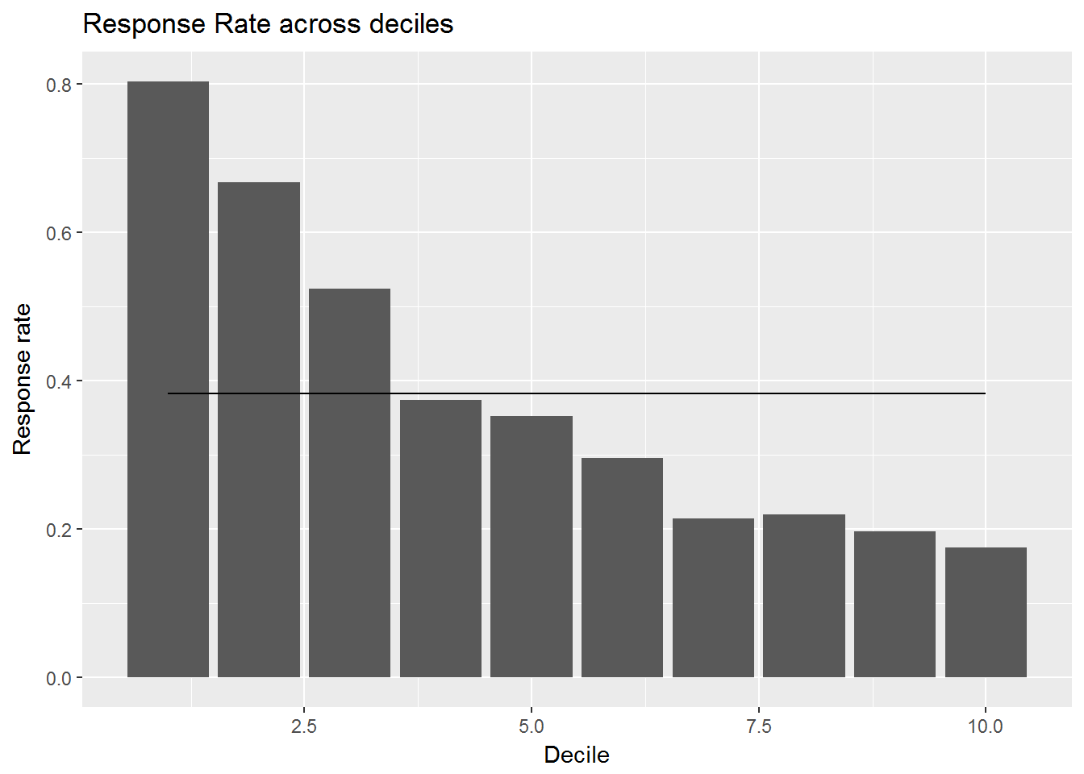
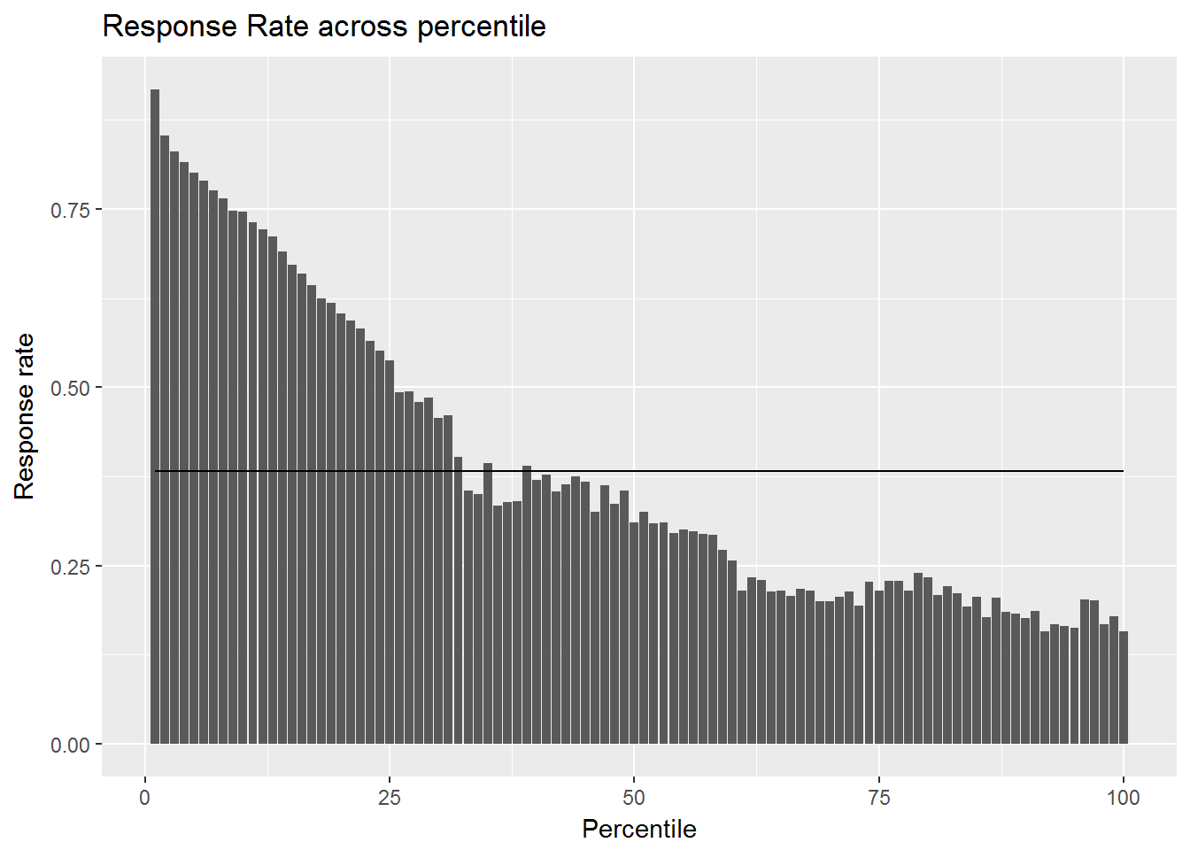
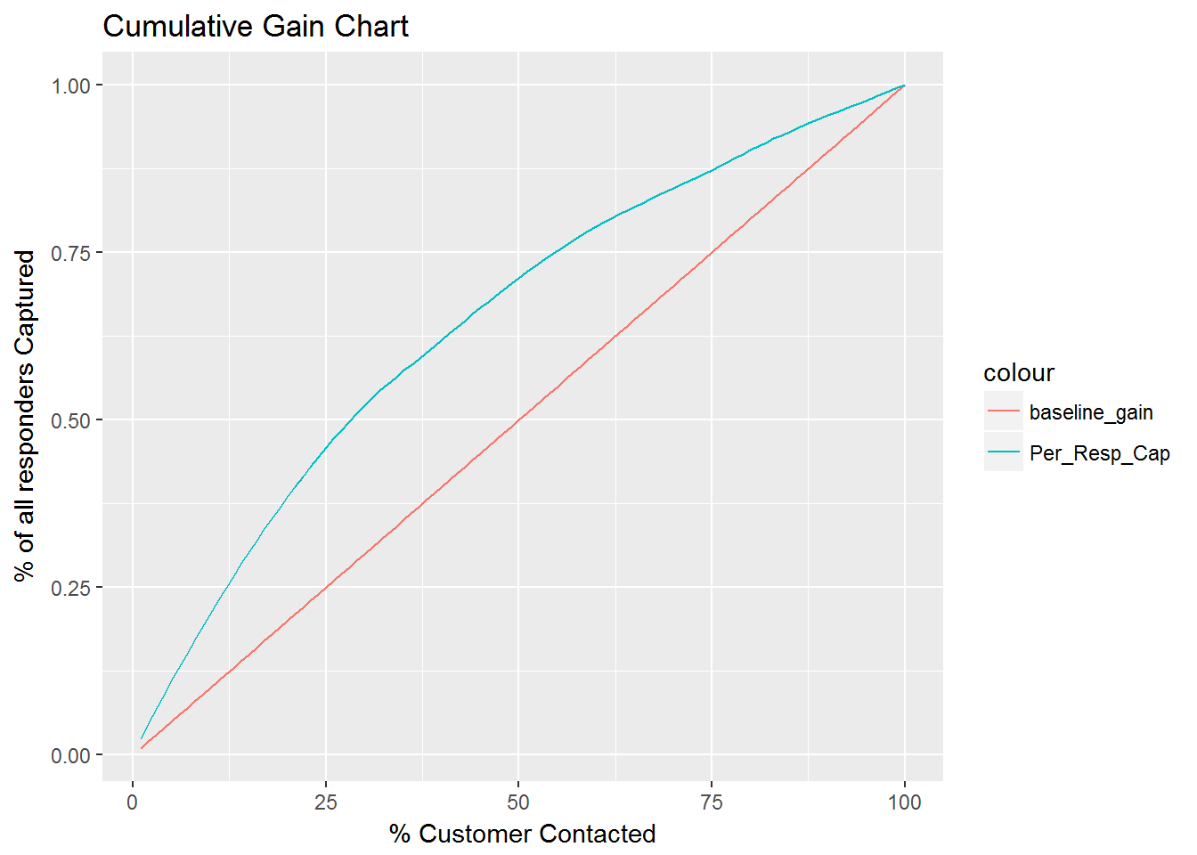
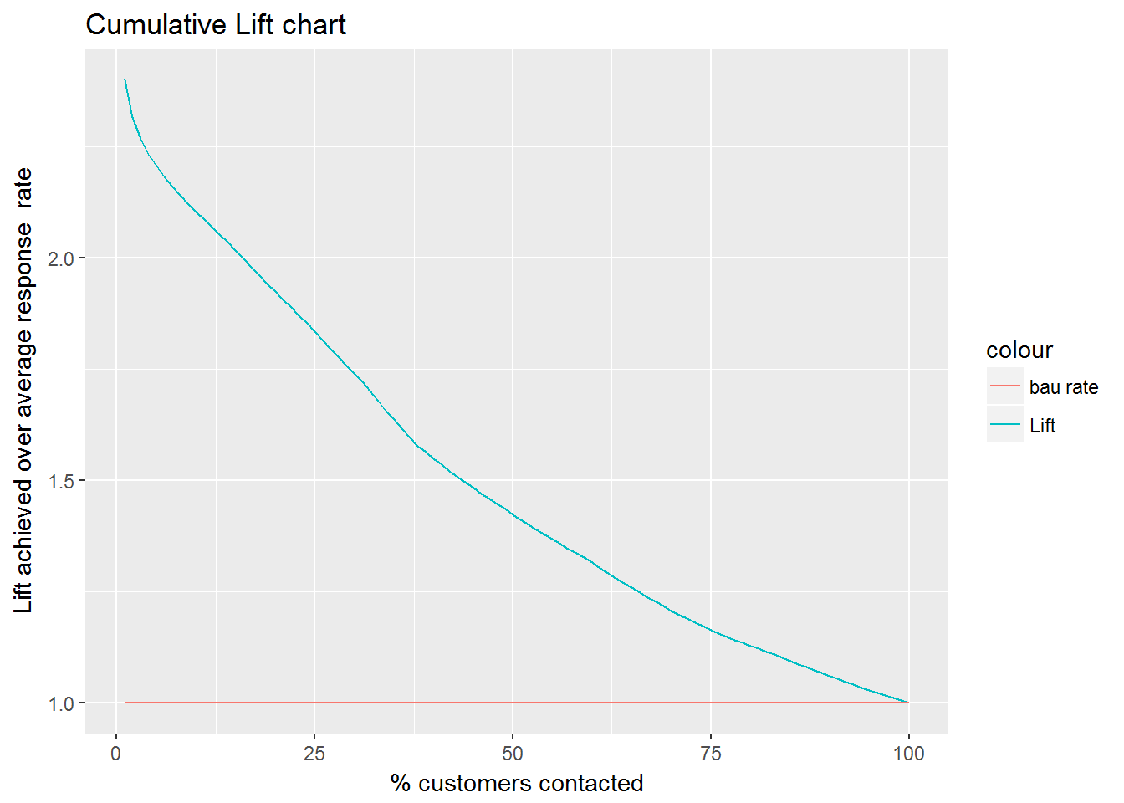
MODEL VALIDATIONS- 6 Months In Time
Decile | Customers | Number of Responder | Cum Responders | Response Rate | Response Gain | Cumulative Response Rate | Lift
1 | 465,752 | 374,418 | 374,418 | 80.39% | 21.03% | 80.4% | 2.10
2 | 465,752 | 310,779 | 685,197 | 66.73% | 38.48% | 73.6% | 1.92
3 | 465,752 | 243,874 | 929,071 | 52.36% | 52.18% | 66.5% | 1.74
4 | 465,752 | 173,993 | 1,103,064 | 37.36% | 61.95% | 59.2% | 1.55
5 | 465,752 | 164,345 | 1,267,409 | 35.29% | 71.18% | 54.4% | 1.42
6 | 465,752 | 137,632 | 1,405,041 | 29.55% | 78.90% | 50.3% | 1.32
7 | 465,752 | 99,987 | 1,505,028 | 21.47% | 84.52% | 46.2% | 1.21
8 | 465,752 | 102,531 | 1,607,559 | 22.01% | 90.28% | 43.1% | 1.13
9 | 465,752 | 91,673 | 1,699,232 | 19.68% | 95.43% | 40.5% | 1.06
10 | 465,752 | 81,447 | 1,780,679 | 17.49% | 100.00% | 38.2% | 1.00
Model Summary:
Among many models , Xgboost algorithm was picked based on model performance.
Response Rate across deciles by median score from 20 models
Response Rate across percentiles by median score from 20 models
Cum Gains using median score from 20 models
Cum Lift using median score from 20 models

Slide 11
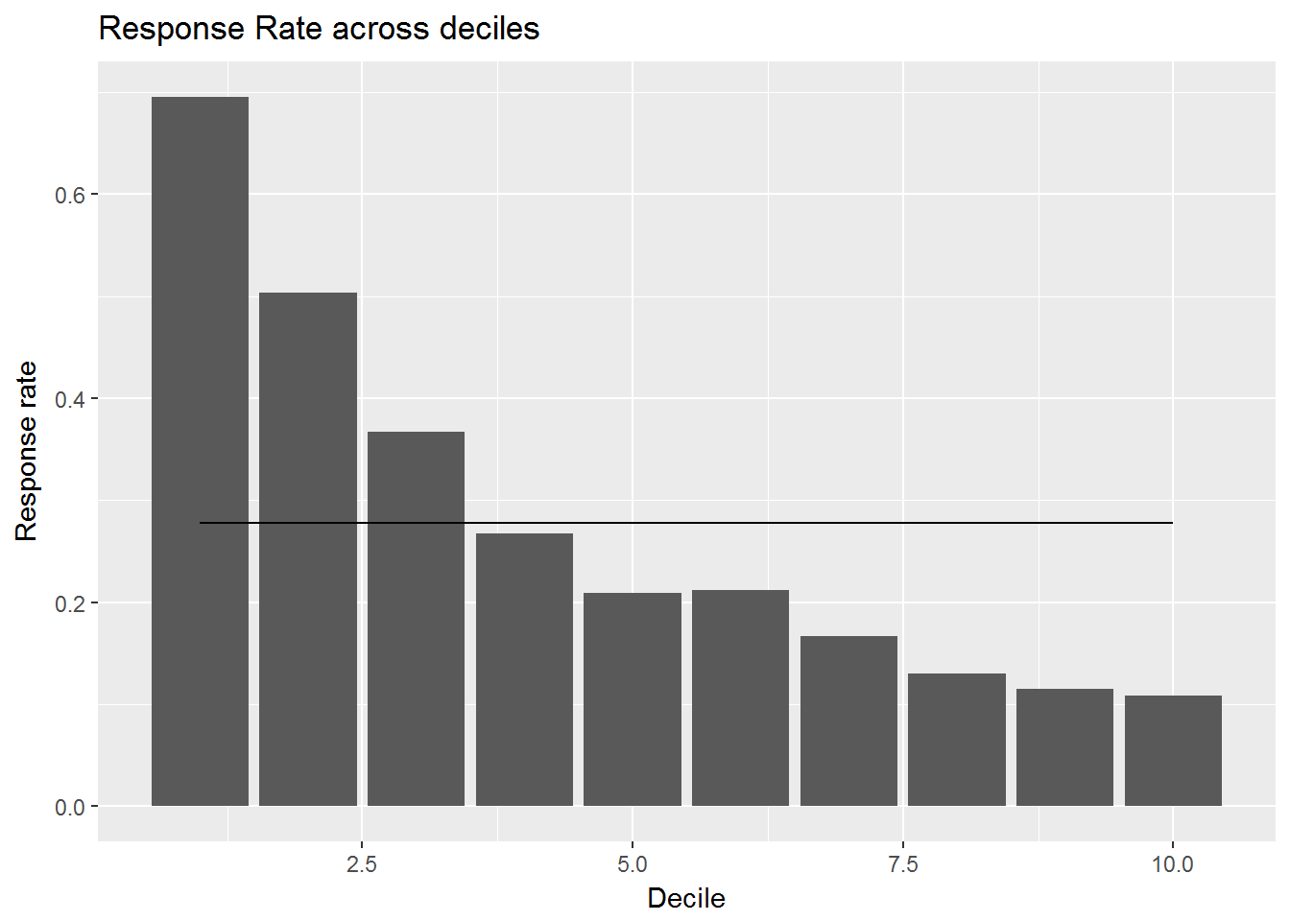
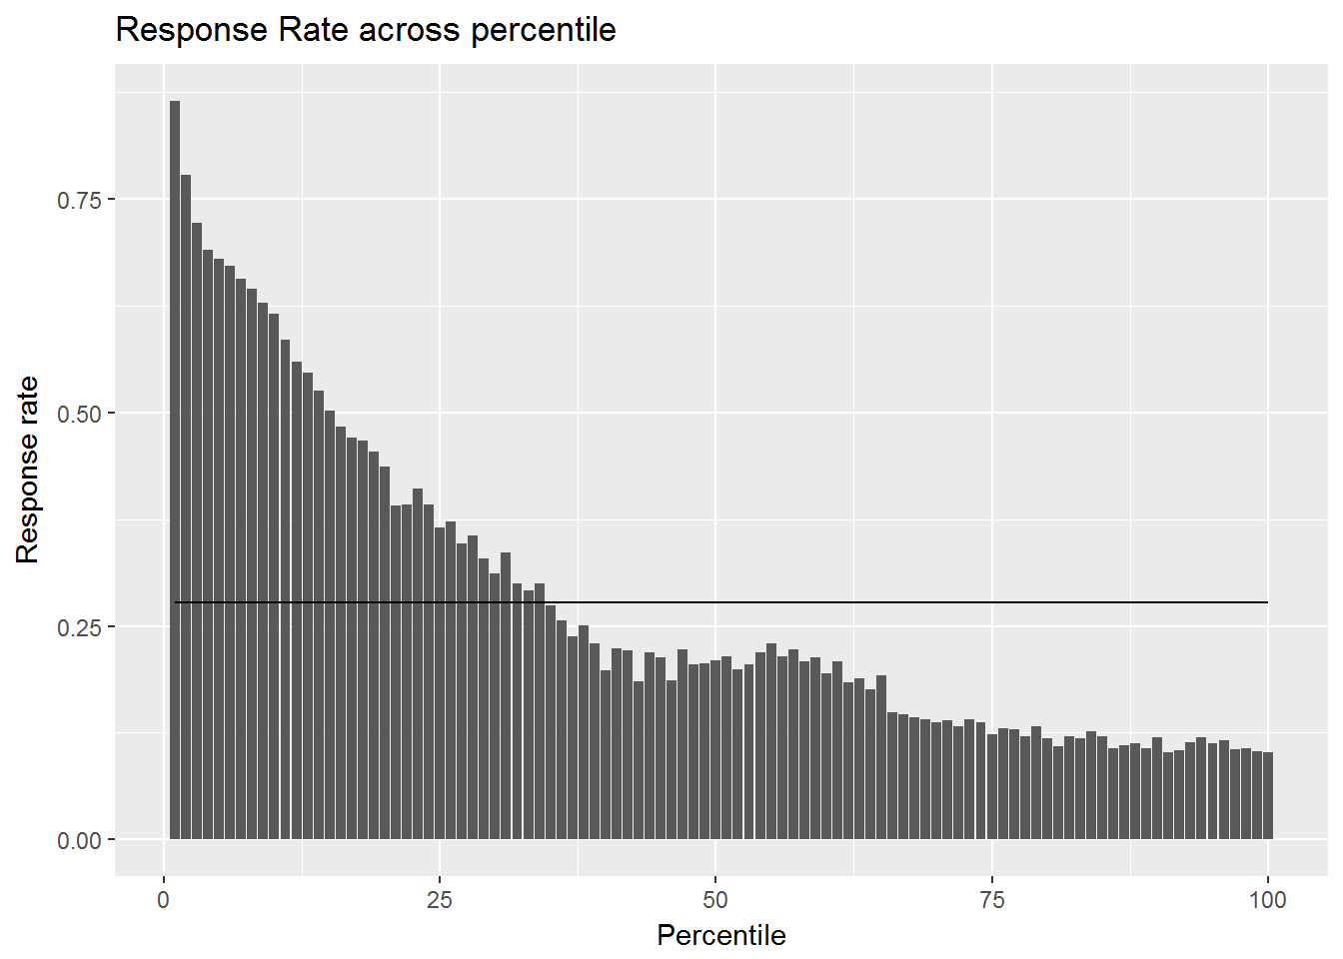

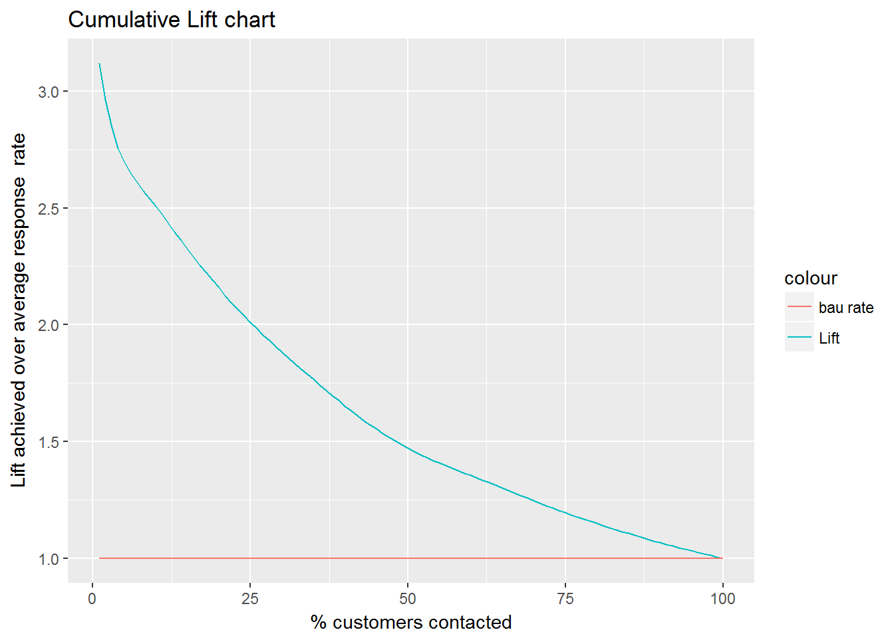
MODEL VALIDATIONS- 6 Month Out of Time
Decile | Customers | Number of Responder | Cum Responders | Response Rate | Response Gain | Cumulative Response Rate | Lift
1 | 429426 | 298688 | 298,688 | 69.56% | 25.07% | 69.6% | 2.51
2 | 429426 | 216031 | 514,719 | 50.31% | 43.21% | 59.9% | 2.16
3 | 429427 | 157440 | 672,159 | 36.66% | 56.42% | 52.2% | 1.88
4 | 429426 | 114789 | 786,948 | 26.73% | 66.06% | 45.8% | 1.65
5 | 429427 | 89895 | 876,843 | 20.93% | 73.60% | 40.8% | 1.47
6 | 429426 | 90965 | 967,808 | 21.18% | 81.24% | 37.6% | 1.35
7 | 429426 | 71488 | 1,039,296 | 16.65% | 87.24% | 34.6% | 1.25
8 | 429427 | 55943 | 1,095,239 | 13.03% | 91.94% | 31.9% | 1.15
9 | 429426 | 49418 | 1,144,657 | 11.51% | 96.09% | 29.6% | 1.07
10 | 429427 | 46627 | 1,191,284 | 10.86% | 100.00% | 27.7% | 1.00
Model Summary:
Among many models , Xgboost algorithm was picked based on model performance.
Response Rate across deciles by median score from 20 models
Response Rate across percentiles by median score from 20 models
Cum Gains using median score from 20 models
Cum Lift using median score from 20 models

